Slide 1

TDD in Midje
Midje概述
lbt05(lbt0506@gmail.com)

Slide 2
TDD(Test Driven Test)
开发流程
  明确当前要完成的功能
  编写相应的测试用例（此时测试并不通过）
  实现功能
  通过测试
  在测试通过的前提下进行代码重构
  循环完成所有功能的开发

Slide 3
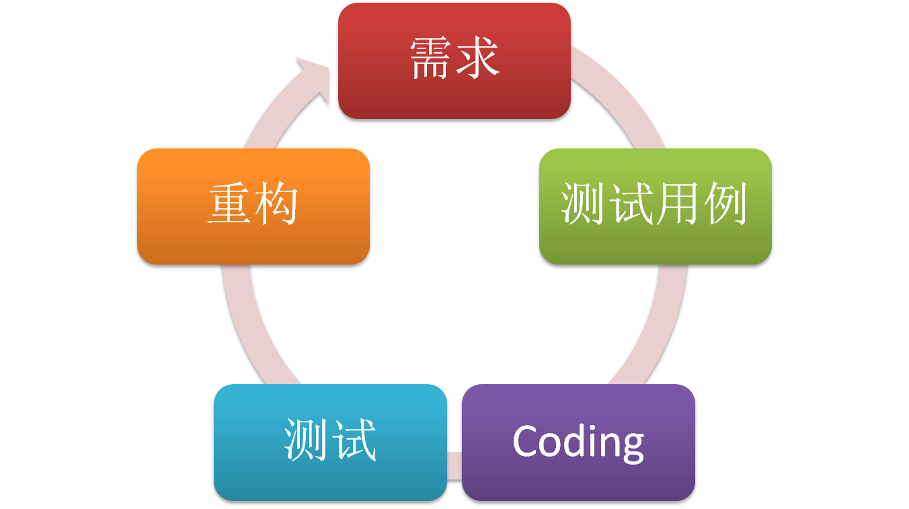
TDD流程

Slide 4
TDD
优点
  KISS(keep it simple, stupid)
  对重构有利
  良好的进度控制、及时正向的反馈
  ……
力所未及之处
  对集成测试、GUI等帮助有限
  并非是万能的，在开发之前已经积累的错误依然需要付出惨痛的代价
  ……

Slide 5
Midje

Slide 6
What is Midje
Midje是一个更灵活，更易读的，更抽象的Clojure测试框架。
支持自顶向下(Top-down)的和自底向上(bottom-up)的测试
https://github.com/marick/Midje

Slide 7
Midje
  基本语法
    fact
    Extended equality
    Checker
  Example
    (fact (+ 1 3) => truthy)
Notes:
fact

Slide 8
TDD in Midje

Slide 9
TDD in Midje
(unfinished numberic-reverse)
(fact (numberic-contains? 123)
=> 321)
Expected: 321
Actual: java.lang.Error: #'numberic-reverse has no implementation. It's used as a prerequisite in Midje tests

Slide 10
TDD in Midje
(unfinished string-reverse)
(defn numberic-reverse [num]
(Integer/parseInt (string-reverse (str num))))
(fact (numberic-reverse 123)
=> 321)
Expected: 321
Actual: java.lang.Error: #'string-reverse has no implementation. It's used as a prerequisite in Midje tests.

Slide 11
TDD in Midje
(unfinished string-reverse)
(defn numberic-reverse [num]
(Integer/parseInt (string-reverse (str num))))
(fact (numberic-reverse 123) => 321
(provided (string-reverse "123") => "321")
)
true

Slide 12
TDD in Midje
(unfinished string-reverse)
(fact (string-reverse "123") => "321" )
(defn numberic-reverse [num]
(Integer/parseInt (string-reverse (str num))))
(fact (numberic-reverse 123) => 321
(provided (string-reverse "123") => "321")
)
Expected: "321"
Actual: java.lang.Error: #'string-reverse has no implementation. It's used as a prerequisite in Midje tests.

Slide 13
TDD in Midje
(defn string-reverse [num-in-string]
(reduce str (reverse num-in-string)))
(fact (string-reverse "123") => "321" )
(defn numberic-reverse [num]
(Integer/parseInt (string-reverse (str num))))
(fact (numberic-reverse 123) => 321
(provided (string-reverse "123") => "321")
)
true

Slide 14
TDD in Midje
(defn string-reverse [num-in-string]
(reduce str (reverse num-in-string)))
(fact (string-reverse "123") => "321" )
(defn numberic-reverse [num]
(Integer/parseInt (string-reverse (str num))))
(fact (numberic-reverse 123) => 321
;(provided (string-reverse "123") => "321")
)
true

Slide 15
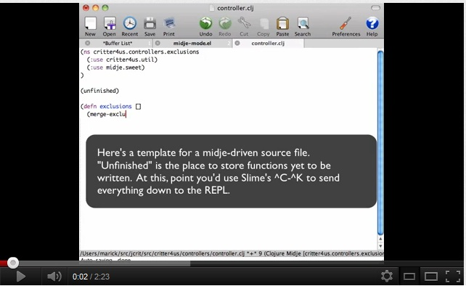
Midje-module
lein exec或者lein test
更好的选择:Midje-module in Emacs

Slide 16
Q&A
Thanks

